Slide 1



Data Generation Toolkit
SFDO Community Sprint; September 2020

Slide 2


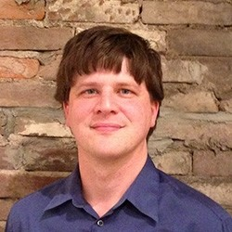

Meet your project leadership team
2005
2008
2010
Cassie
(she/her)
Aaron
(he/him)
Samantha
(she/her)

Slide 3
Icebreaker!
Would you rather be an astronaut or a SCUBA diver?

Slide 4
The problem
There is no simple, reliable, affordable, admin-friendly way to generate valid test records and move them between Salesforce environments.

Slide 5
The solution
Develop tooling and an admin-friendly UI to create valid test data. (In progress)
Create clear, precise, empowering documentation of currently available products/tools and scenarios where they are most appropriate. (In progress)

Slide 6

PROJECT TIMELINE
Fall 2019 Sprint
March 2020 Sprint
May 2020
Today!
Project established at Philadelphia Sprint
Defined use cases, decided that Snowfakery does a good job solving the technical problem
Officially accepted into Commons program! Started working on Personas and community survey.
We have lots of work to do together!

Slide 7

Snowfakery is improving all the time
Paul started developing Snowfakery after the Philadelphia Sprint. It is now packaged as part of CCI and capable of tackling many use cases.
Read the docs

Slide 8
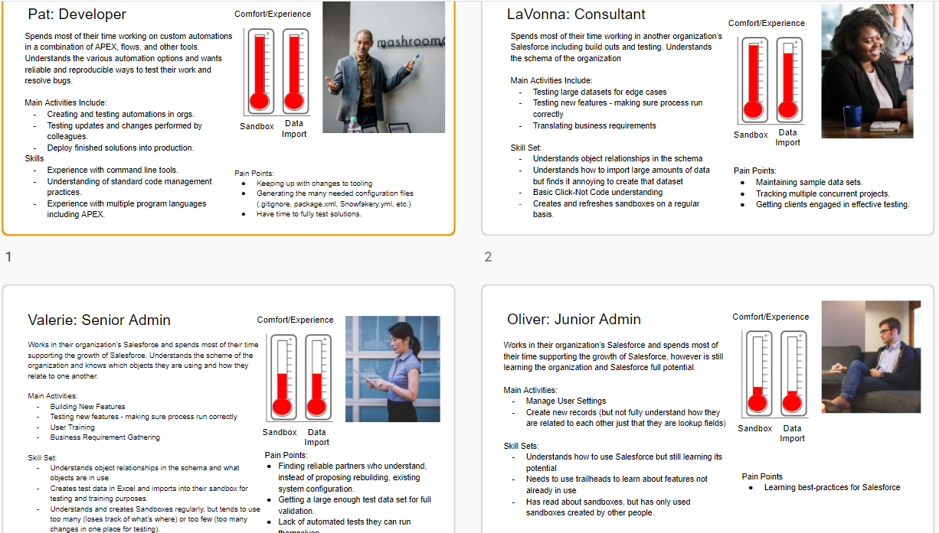
Personas - organize user stories into categories
Visit personas slides here

Slide 9
Survey to understand community needs and competencies
Survey was administered from mid-July to mid-September. We have~75 responses.
Next step: Compile results and insights.
View responses

Slide 10
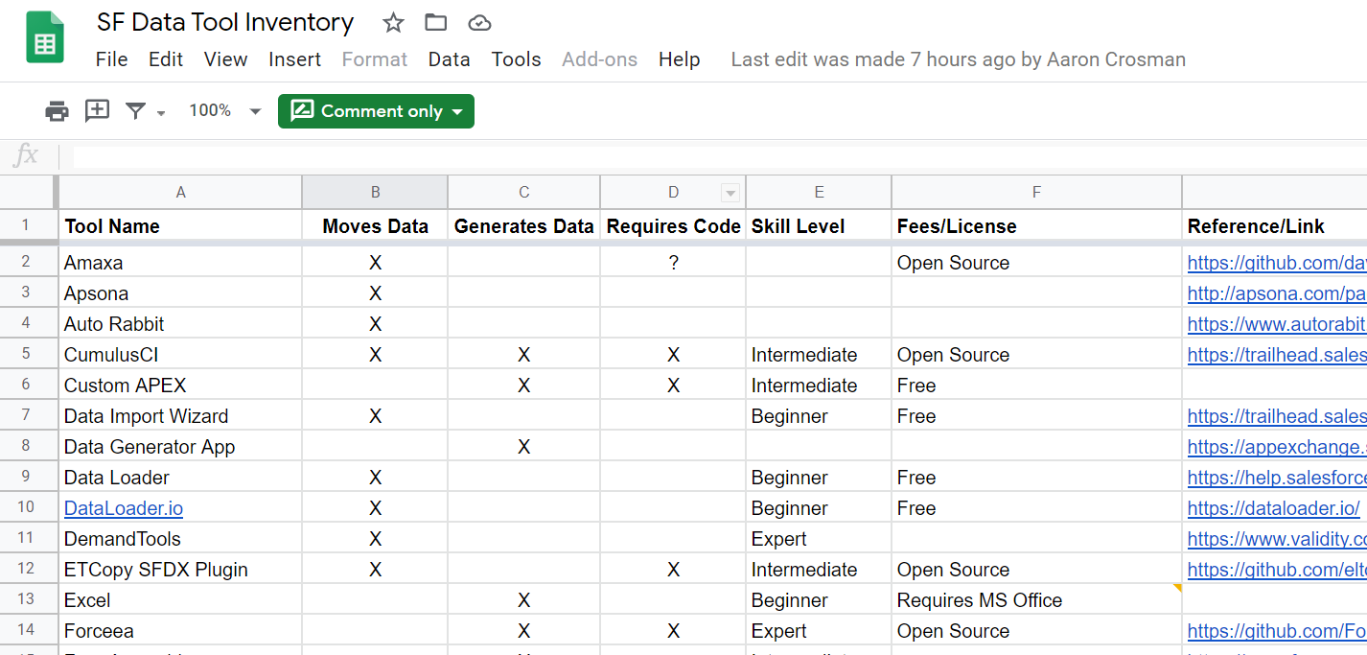
Tracking tools for Data Generation and Data Moving
Next step: Move to a new collaborative workspace; Start documenting.
View spreadsheet

Slide 11

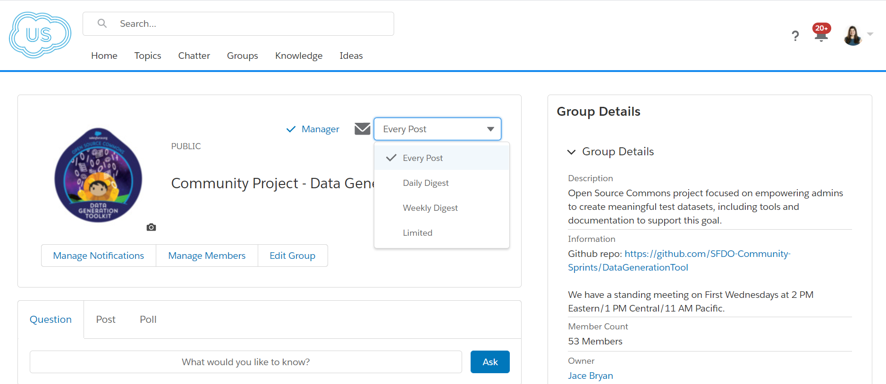
Join us in the Power of Us Hub and turn group notifications “on”

Slide 12

Sprint Projects - Documentation (Issue #12)
Project
Point person
Group members
Create documentation template/outline (priority) | Cassie | Rebecca, Michael Kolodner, Samantha
Use template to begin documenting tools and processes for Data Gen and Data Moving
Review CCI documentation and provide feedback

Slide 13
Sprint Projects - Tooling
Project
Point person
Group members
Requirements and wireframes for Snowfakery UI (priority) (Issue #4) | Aaron, Paul | Lawrence, Jung
Create Snowfakery “recipes” (Issue #1, 6, 8, 9)

Slide 14
Sprint Projects - Misc
Project
Point person
Group members
Analyze survey results (priority) | Rebecca | Deborah, Marciana
Document steps for using CCI to move NPSP Trial data from a Trial Org to a Sandbox

Slide 15
Sharing docs
Use THIS FOLDER to store docs in a central repository. We will later migrate them to our Github Repo.
Email samantha.shain2010@gmail.com to request access.

Slide 16
Use our editable graphic resources...
You can easily resize these resources without losing quality. To change the color, just ungroup the resource and click on the object you want to change. Then, click on the paint bucket and select the color you want. Group the resource again when you’re done. You can also look for more infographics on Slidesgo.

Slide 19
JANUARY
FEBRUARY
MARCH
APRIL
MAY
JUNE
PHASE 1
Task 1
Task 2
PHASE 2
Task 1
Task 2
JANUARY
FEBRUARY
MARCH
APRIL
PHASE 1
Task 1
Task 2

Slide 22
...and our sets of editable icons
You can resize these icons without losing quality.
You can change the stroke and fill color; just select the icon and click on the paint bucket/pen.
In Google Slides, you can also use Flaticon’s extension, allowing you to customize and add even more icons.

Slide 23
Educational Icons
Medical Icons

Slide 24
Business Icons
Teamwork Icons

Slide 25
Help & Support Icons
Avatar Icons

Slide 26
Creative Process Icons
Performing Arts Icons

Slide 27
Nature Icons

Slide 28
SEO & Marketing Icons

Slide 29


